Slide 1
Front-End Web Development Best Practices
1
Notes:
<number>

Slide 2
SUMMARY
Evolution of JavaScript and Web Development
Editor and Configuration
Package Management
Linting
Code quality
Testing
CI / CD
Resources
Conclusions
Personal experience
Course and books
1

Slide 3
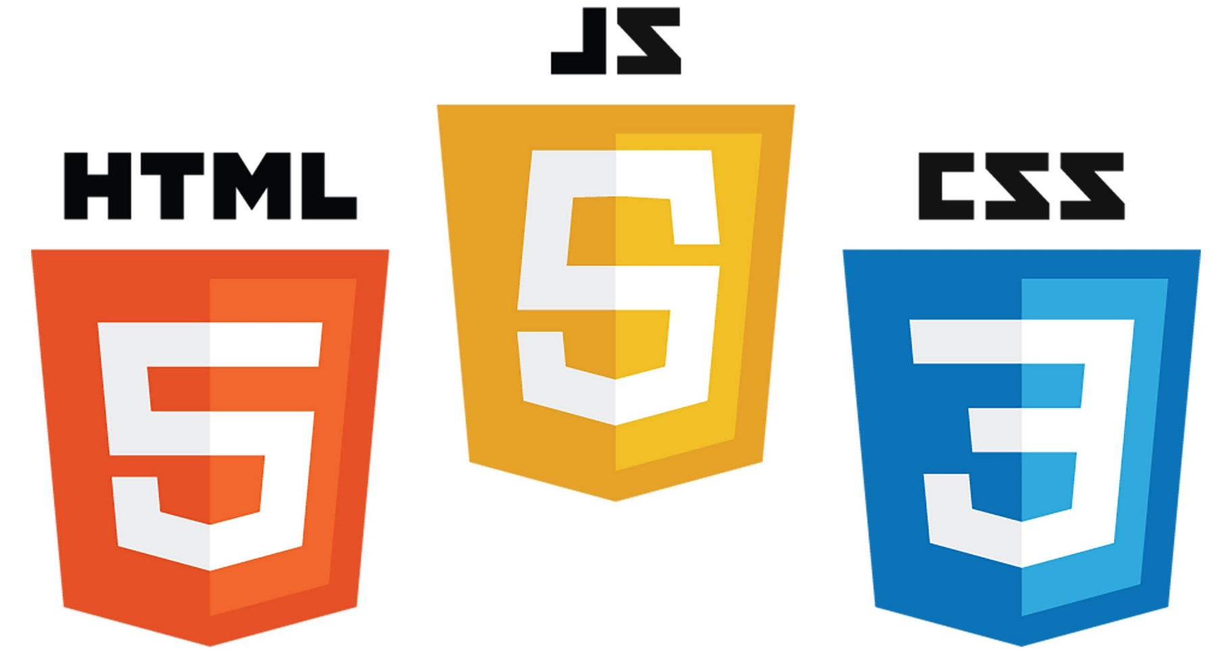
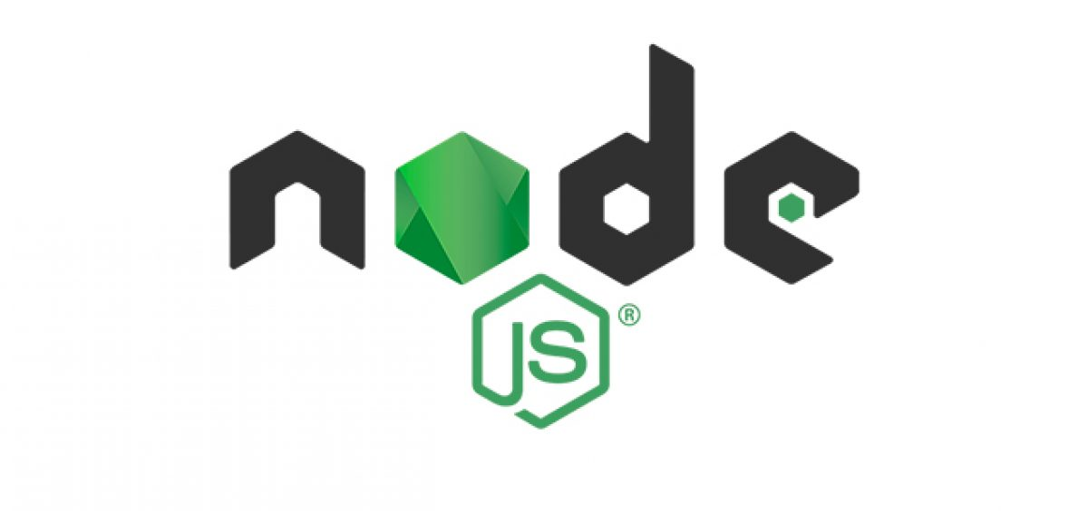
Evolution of JavaScript and Web Development
https://www.w3schools.com/js/js_versions.asp
1

Slide 4
Timeline recap
1990 - 1995: HTML, CSS and JavaScript are invented
1996 - 1999: Standardization efforts begin. Browser compliance is terrible. Browser wars ignite.
2000 - 2004: CSS frameworks begin to emerge. jQuery is born. Frontend package management.
2005 - 2009: W3C specification compliance is met. Chrome browser takes the lead. Responsive designs and frameworks are introduced.
2010 - 2015: JavaScript Frameworks are born i.e. Backbone, Ember, AngularJS, React, Angular, Vue. HTML5 is announced.
2016 - 2018: GraphQL emerges. Native HTML, CSS & JavaScript become more powerful. New platforms built on-top existing JavaScript frameworks emerge: StoryBook, Motion UI, Gatsby, Next.js.
1

Slide 5
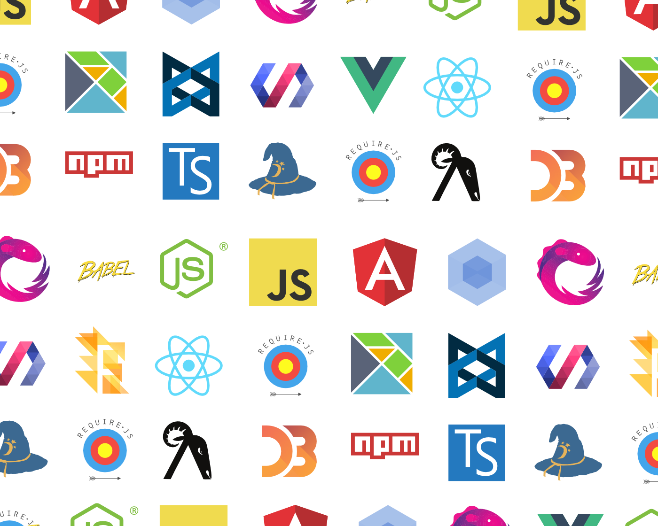
REALITY
1

Slide 6
Before start a Project
The list of choices is LONG
The list is COMPLEX
Is hard to Start from scratch
Developers with less experience have a hard time at the beginning
Designers are not developers, in principle
The team needs to think about a good design before starting to develop
The team have to go in the same direction

Slide 7
Tools for have a better experience in Software Development
People of IT in WDNA:
...we are Software Engineers most of the time...

Slide 8
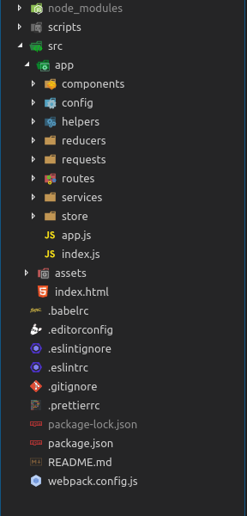
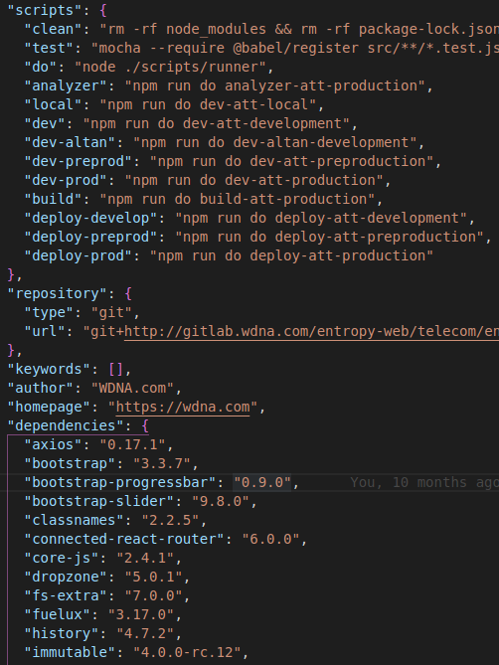

Starter Kit
We need a Starter Kit
Doctors have Starter Kit
Code conventions
Package Management
Optimizations
Common Libraries
Some Tests
Folders structure
Example Working App
Initial Dependencies
Everything is not Entropy compatible....

Slide 9

Editors and Configuration
The list of choices is LONG
The list is COMPLEX
The team have to go in the same direction
A good choice could be an Editor with:
Autocompletion
Framework support
Lightweight
Built-in terminal
100% Customizable
Free

Slide 10
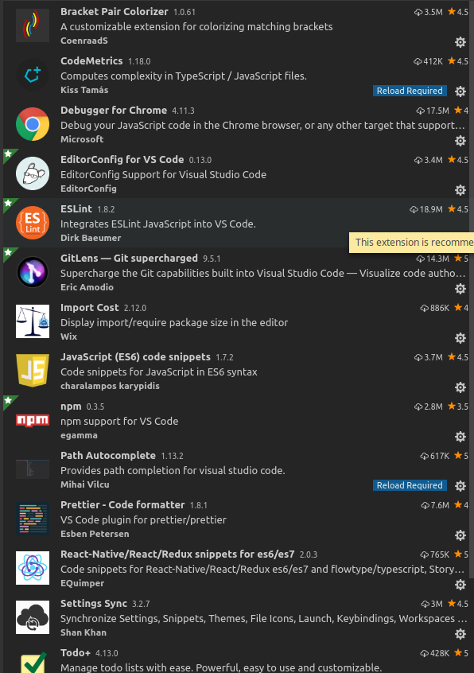
Configuring Visual Studio Code
Take the course... completely
Extensions
Snippets
Git integration
Editorconfig
SettingSync extension
Waka Time extension
Take a while configuring the editor,
most of the time you use it
https://editorconfig.org/

Slide 11

Package Management
Node Package Manager
Basic commands
Managing Dependencies with package.json
Locking-Down Dependencies
Development Packages
Production Packages
Keep dependencies updated
Automation scripts
Read the docs...

Slide 12

Library Selection
How widely is it used?
How is the documentation?
How actively is it being developed?
GitHub activity, stars...
NPM downloads
If we’re not careful with our decisions during the beginning, we will end up spending a lot of time later cleaning up the mess.

Slide 13
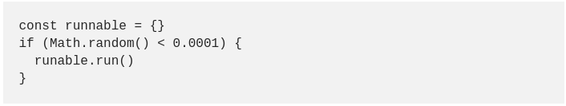
Linting
... PHPLint, JSLint, Pylint, ES Lint ...
What is “Linting”?
Linting is the process of running a program that will analyse code for potential errors.
Why do we need a linter?
Live Example (wdna-test)

Slide 14


Linting
Why do you need a linter?
Readability
Pre-code review
Finding (syntax) errors before execution
Avoid Mistakes
Avoid Bad practices or patterns
Enforce consistency
The team have to go in the same direction
Why Facebook, Airbnb and Google uses ES Lint?
ES Lint with Airbnb Rules
+
Live Example Highcharts Component without ESLint

Slide 15
Linting
Things to do or not do with a linter:
To do
Follow a good JavaScript, PHP, Python style guide
Google, Facebook, Airbnb....
Everything should follow linter rules
Take a while configuring linter rules, will be the rules of the TEAM
Not do
Disable the rule instead of improving you code
Think that the linter eliminates all the errors of your code

Slide 16



Popular code style guides
PSR-2
Airbnb, Google...
Google, etc

Slide 17
Code quality
There isn't another way
Clean Code
Test Driven Development
Solid Principles
Design Patterns
Keep reading, studying...
...we are Software Engineers most of the time...

Slide 18
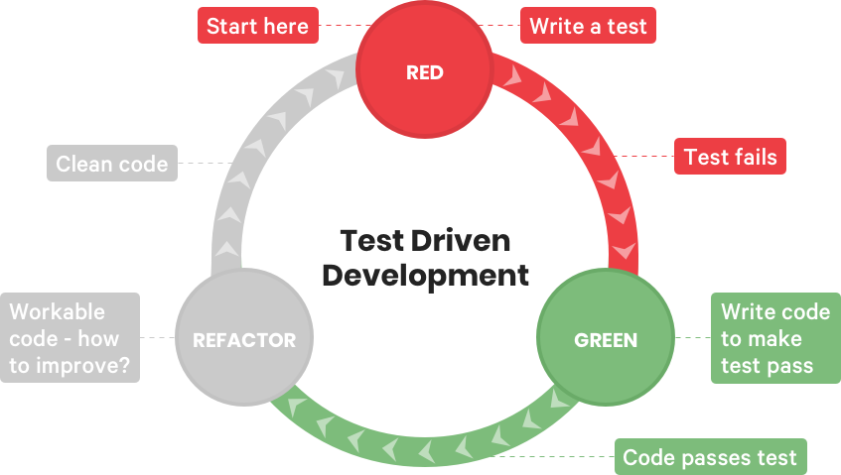
TDD

Slide 19
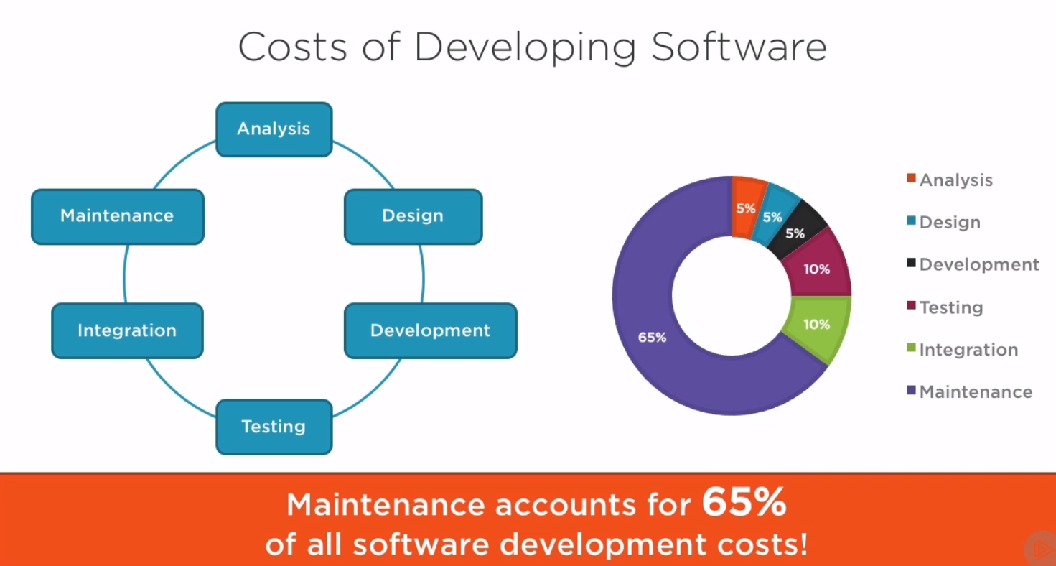
Tip

Slide 20
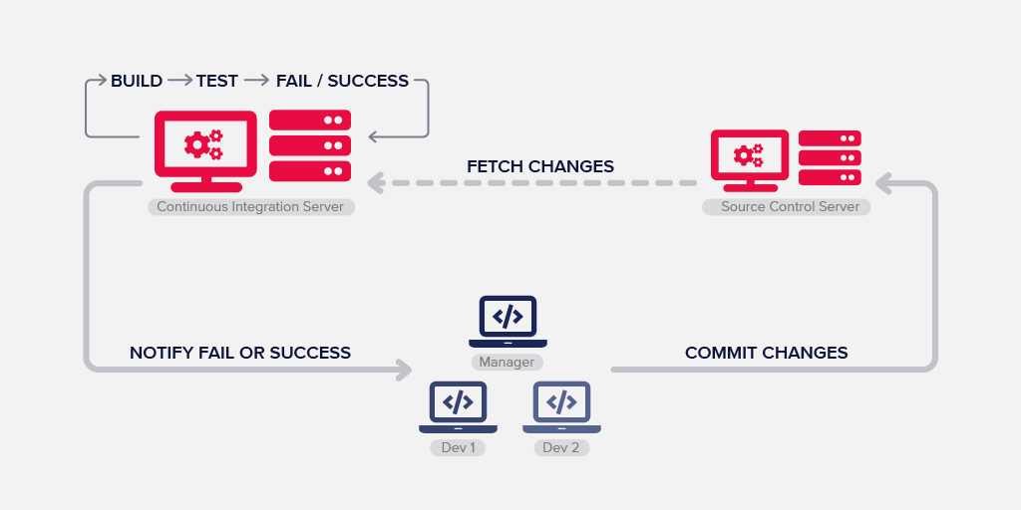
CI / CD
Small Example of wdna-test
Guide 1
Guide 2

Slide 21

Courses
Clean Code: Writing Code for Humans
SOLID Principles of Object Oriented Design
How to Have a Better Career in Software
Design Patterns Library

Slide 22
Summary
This is for NOW not for the future
From now on all the code that is generated in the Front-End must be correctly formatted
We need to start using industry-standard tools
Study this and we will prepare another smaller talk specifically of entropy-front project, next week
QUESTIONS???
Ryan Dahl
10 Cosas de las que me arrepiento de Node.js

